Slide 1
Blockchain-based Personal Health Data Sharing
System Using Cloud Storage
CRYPTOGRAPHY (BITS-F463)
TERM PROJECT

Slide 2
Abstract
With the advent of rapid development of wearable technology and mobile computing, huge amount of personal health-related data is being generated and accumulated on continuous basis at every moment. These personal datasets contain valuable information and they belong to and asset of the individual users, hence should be owned and controlled by themselves. Currently most of such datasets are stored and controlled by different service providers and this centralised data storage brings challenges of data security and hinders the data sharing. These personal health data are valuable resources for healthcare research and commercial projects. In this research work, we propose a conceptual design for sharing personal continuous- dynamic health data using blockchain technology supplemented by cloud storage to share the health-related information in a secure and transparent manner. Besides, we also introduce a data quality inspection module based on machine learning techniques to have control over data quality. The primary goal of the proposed system is to enable users to own, control and share their personal health data securely, in a General Data Protection Regulation (GDPR) compliant way to get benefit from their personal datasets. It also provides an efficient way for researchers and commercial data consumers to collect high quality personal health data for research and commercial purposes.

Slide 3
Roles of stakeholders
Users
Key keepers
Customers
To produce, upload and share (sell) personal health data and get monetary or service benefits.
To keep the private keys to decrypting the data, and assist transactions.
They will get monetary benefits for every validated transaction.
To buy user data and provide monetary or service rewards to users and key keepers.

Slide 4
Aspects of a Transaction
Data Quality Validation
Data Sharing Transaction Validation
Cloud Storage
Data Encryption
Crypto-Currency
General Workflow

Slide 5
Data Quality Validation
User must record data using certified instruments that guarantee precision and credibility.
Valid Hardware produces reliable output, hence makes the data more valuable.
After the hardware validation the data to be marketed must be relevant. This is verified by advanced machine learning techniques
ML techniques produce quality classifiers that can retain useful information and discard the noise.

Slide 6
Data sharing transaction validation
This is where Blockchain model comes into play. Users’ transaction history is stored as blocks. But the data itself cannot be stored in the blocks owing to their size. Additionally:
Cryptocurrency is introduced here to represent certain monetary value.
Standard coin API is utilized to ensure compatibility with any wallet.
Personal details such as name, address, social security number (aadhar no.) will be anonymised.

Slide 7
Cloud Storage
The main reason for integrating cloud storage into the data sharing system is to provide an off-chain storage solution for the large size dataset. The continuous- dynamic data are usually collected with high frequency during a long- term process.
The blockchain is replicated distributed datastore, where the transactional data will be replicated across many nodes such as mining nodes. Therefore, blockchain is not ideal for storing large amount data due to its replication across various nodes.
Hence the use of tools such as Amazon Web Services or Google Cloud is more appropriate.

Slide 8
Data Encryption
To ensure security and privacy, the data will be encrypted before uploading to the cloud by the user App using symmetric-key algorithms like Rijn-dael AES in combination with a threshold encryption scheme. Then the symmetric key for decrypting the data will be split into multiple shares using the Shamir’s secret sharing technique and the key shares will then be distributed among different key keepers. The minimum number of key keepers for decrypting the data is determined by the total number of key keepers and the blockchain security model. To be able to download the encrypted data, one has to obtain both the link and authentication to the data. Then he/she has to get enough key shares of the encryption key to decrypt the data. Theoretically, they can only get these information through a validate transaction approved by the blockchain nodes.

Slide 9
CryptoCurrency
As benefits to the users the consumers can provide services such as healthcare,disease monitoring,diagnosis or consultation. But these kind of benefits might not be appealing to all users hence we resort to providing monetary benefits instead.
We come up with our own Crypto Token as a solution which can be generated or mined by putting the data on the blockchain-enabled system to facilitate for transactions. It is expected to support exchange with other cryptocurrencies or real currencies in future when the network has enough nodes and participants.

Slide 10
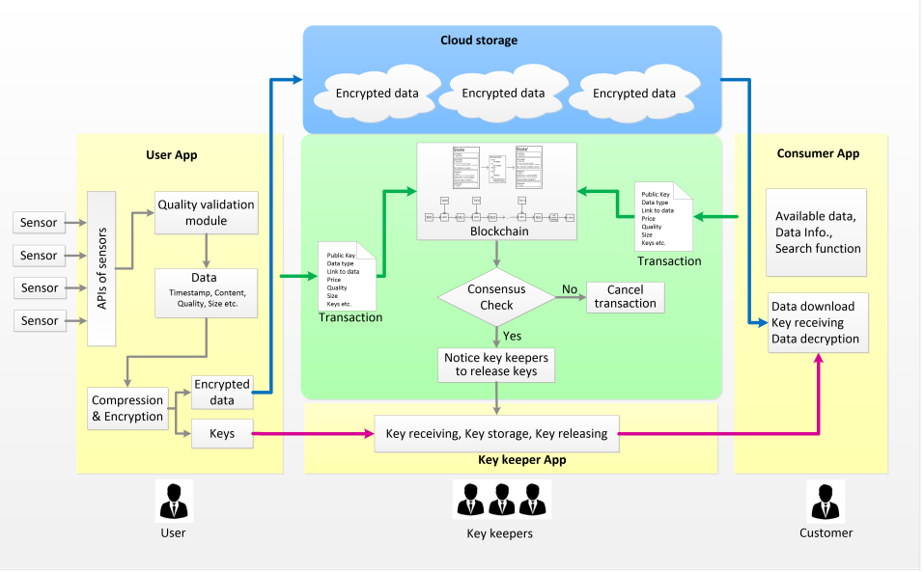
General Workflow.

Slide 11
DATA PRIVACY AND SECURITY ANALYSIS
Restricted access to the cloud.
Data is encrypted before upload to the cloud.
Compromise in the cloud service doesn’t compromise with secrecy.
Decryption key is split and distributed among multiple key-keepers.
Compromise of single key-keeper doesn’t compromise the entire key.
Data transaction process is secured by hash functions and public-key signature schemes utilised in blockchain contracts.

Slide 12
COLLABORATORS:
Nikhil.L (2016B4A70507)
Inderraj Singh (2016B4A70473H)
Srividya.A (2016B3A70491)
Shantanu Gupta (2017A7PS0137)
Lokesh Mehra (2018A7PS0268)

